Slide 1


Slide 2




Refinitiv Workspace:
Be a step ahead of your peers
Technology and performance
    Significantly lighter install that reduces deployment time and cost
    Interface designed from latest web browser technology allowing seamless onsite and remote access
    Universal access on Windows and Mac OS, mobile and Microsoft Office
Open platform for workflow
    Seamless, interoperable and collaborative data-powered workflows
    Sophisticated models offer unique insights beyond spreadsheets
    Data access across any in-house or third-party applications on your desktop
Intelligent and smarter
    Adaptive framework for Banking, Wealth Advisory, Asset Management, and Trading
    Faster, smarter and more relevant results, with instant previews as you type
    More powerful structured and natural language search driven by machine learning
Tailored user experience
    Familiar browser paradigm and navigation menus to access most relevant tools
    Top apps revamped and improved for an improved overall user experience
    Become certified and get a leg-up as you move into the workforce and benefit from a stronger curriculum that fosters applied learning.

Slide 3
What challenges are academic institutions facing today?
Virtual Learning
Productivity
AND EFFICIENCY
SECURITY
License Management
Managing virtual learning effectively with minimal disruption during the COVID-19 pandemic has become a rapidly expanding challenge for institutions.
Ensuring both educators and students have access to financial intelligence is essential even if they are away from campus.
Academic institutions need to provide students best-in-class solutions to boost results, giving them a head start as they transition into the workforce.
The need to advance applied learning and have a user experience that boosts productivity with non-tailored solutions is difficult.
Making sure that students who have graduated from or left the university are not able to access databases.
It is challenging to deactivate licenses immediately after a student leaves the university due to limited resources for license management.
    Academic institutions have limited resources to manage license management effectively.
    Individual license models means licenses need to be assigned and unassigned as students join and leave.
REFINITIV WORKSPACE IS A POWERFUL AND INTELLIGENT LEARNING SOLUTION THAT MEETS THE NEEDS OF BOTH STUDENTS AND EDUCATORS

Slide 4
UNRIVALLED CONTENT AND MARKET DATA

Slide 5
Access the broadest and deepest coverage
LEVERAGE APPLIED LEARNING USING REAL-WORLD DATA AND STATISTICS
40 BILLION Daily market data updates | 92.5 MILLION Company financial data | 51 MILLION Estimates and KPIs | 52.8 MILLION Research pages per year from 1,300 firms | 9.5 MILLION Economic time series | 1.3 MILLION Equity quotes from 325 exchanges
Market data and pricing The widest available range of cross-asset data through low-latency, real-time and bulk-content delivery systems. |  |  |  | Company data Comprehensive and timely information to inform in-depth, bottom-up analyses. The leading provider of detailed company data. |  | Reference data Data to support security master and enterprise data management and asset set-up. Index constituents & weightings Industry classifications Symbology Terms and conditions
Indices Benchmarks Lipper Fund data Equities Derivatives & options | Derivatives & options Exchange-traded funds Evaluated pricing Fixed income Foreign exchange – FX and interest rate polls |  | Futures Loan pricing Municipal bonds New issues Real-time pricing | Bond holdings Business classifications Credit (CDS) Company news Corporate actions Debt new issues Entity risk (corporate structures) ESG data (ranking and ratings) Estimates Equity new issues Events & transcripts Fundamentals | Investment research Mergers and acquisitions People data Ownership Private company data Shareholder activism Intelligence Shareholding disclosures Syndicate loans and project finance Venture capital and private equity data
 |  |  |  |  |  | Analytics Unique data sets support idea generation, due diligence and decisions. Deal analytics StarMine® quantitative analytics and models
Economic data The largest collection of global economic time series content in the industry. Global key indicators National sources and calendars International historical sources Forward-looking economic indicators |  | News and insight Extensive coverage from the world’s leading financial news organization. Reuters News Third-party news sources and news wires Thomson Reuters news Analytics and MarketPsych Indices |  |  |  | Analytics Unique data sets support idea generation, due diligence and decisions. Deal analytics StarMine® quantitative analytics and models

Slide 6
NEXT-GENERATION
FINANCIAL INTELLIGENCE

Slide 7

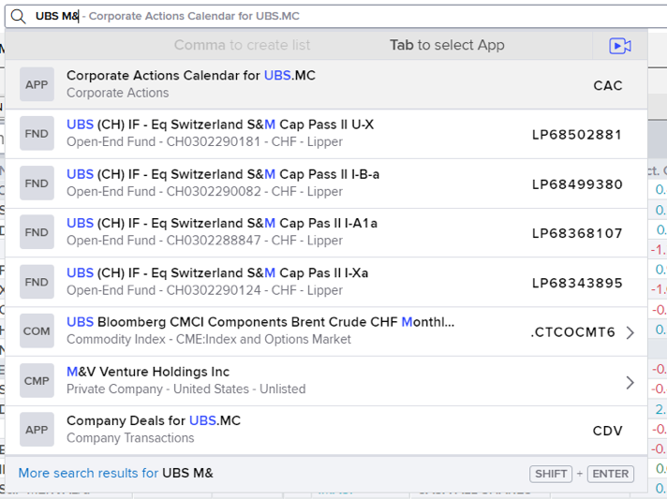
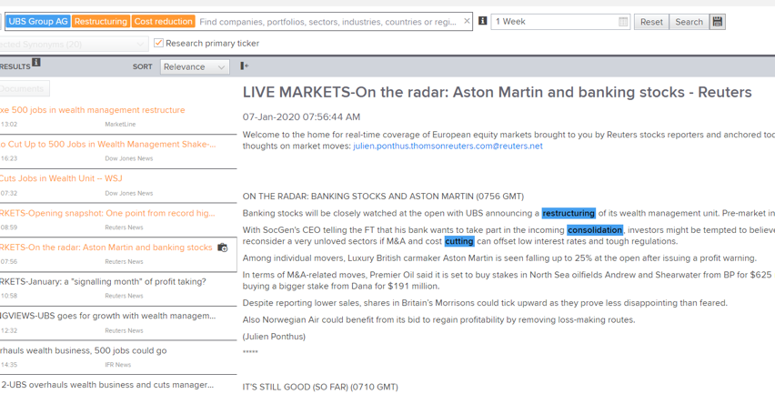
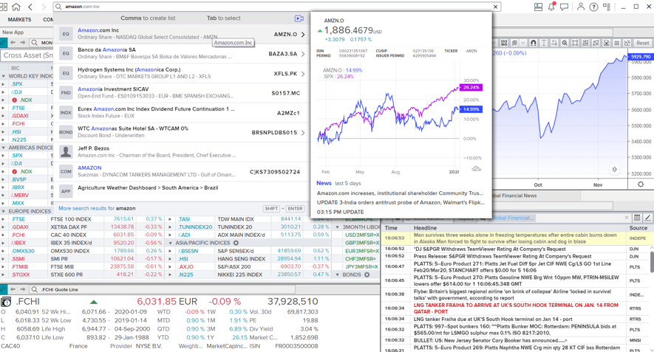
Bringing financial intelligence to academic institutions
1
Boost your research with AI-powered search
We have built a much smarter, real-time financial market search facility that returns highly relevant results with minimal input.
With AI-powered intelligent search you can find the content students are looking for straight away, so that that they can focus on what’s important and boost their research and learning.
2
Snapshot previews display key info quickly
Designed to show preview results with minimal screen interruption or searching, snapshot previews enables students to access the content they are looking for straight away, without even having to click search.

Slide 8
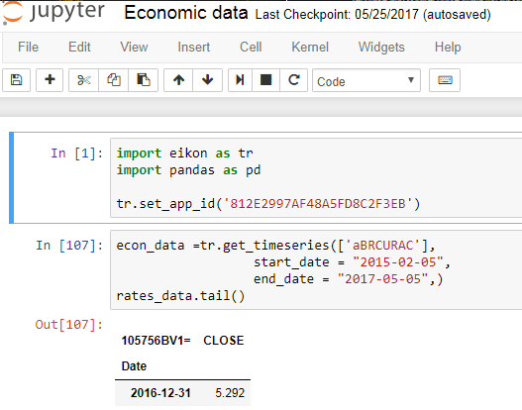
Bringing financial intelligence to academic institutions
3
Enhanced multi-platform experience
Students can continue their research seamlessly even away from university by accessing Workspace from their personal desktops or tablet via workspace.refinitiv.com/web
4
Open and agile
Students can conduct deeper data modeling and analysis with modern APIs and popular languages like Python, helping them broaden their knowledge of the markets.
They can also access the raw data, extract it, build it into models and applications – open access to our data – to drive innovation and your research.

Slide 9
Bringing financial intelligence to academic institutions
5
Single sign-on and license management capabilities
Single sign-on (SSO) ensures students will have a seamless user experience overall, boosting their productivity and helping them gain time to focus on what is important. SSO allows them to save searches, preferences, language settings, then sign off and pick up exactly where they left off without having to start all over again – giving them a customized and best-in-class personal experience.
Equally, SSO also gives educators greater control and lessens security concerns as it facilitates the deactivation of credentials when a student leaves the university or that user is no longer entitled to access Refinitiv Workspace.
Dedicated license management capabilities also facilitate this process, helping administrators manage licenses effectively and easily without resource constraints as students join and leave their academic institutions.

Slide 10
THE JOURNEY BEGINS TODAY

